Slide 1
McEliece Cryptosystem
M. A. Kachaou

Slide 2

July 22, 2020
7 Finalists
8 Alternates
“Post-Quantum Cryptography Standardization Process”

Slide 3
Easy to Construct
“Hard Problems” --- Puzzles
Hard to Solve
Quantum Computers

Slide 4
Five Major Types of Hard Problems Under Consideration
Multivariable Polynomial Problems
Hash Function Problems
Elliptic Curve Isogenies
Lattice Problems
Code Problems
Classic McEliece

Slide 5

Robert J. McEliece, 1942–2019

Slide 6
McEliece System
(OW-CPA)
A Random Binary Goppa Code
Public Key
EVE
Codeword
+
Random Errors
Ciphertext
Codeword

Slide 7
Dozens of Attack Papers Over 40 Years
Private Key
Ciphertext
Identifying and Removing The Errors
2^64 Security
"Overkill"
Codeword

Slide 8
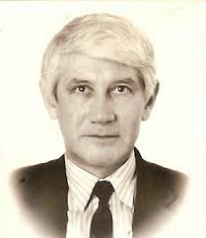

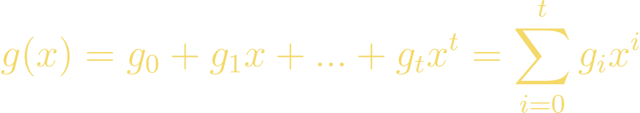

Binary Goppa Codes
Introduced in 1970
A Linear, Error-Correcting Code Defined over
𝑝 being a prime
Valery Goppa

Slide 9





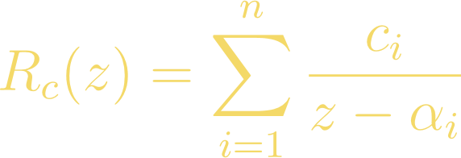
With each
Let 𝐿 be a finite subset of the extension field
St.
For all
Given a codeword vector
Over

Slide 10




is the unique polynomial with
with a degree less than or equal to 𝑡− 1.
A Goppa code
is made up of all code vectors 𝑐 st.
This means that the polynomial 𝑔(𝑥) divides

Slide 11
Recall that Goppa codes are linear codes. As such, we can use the notation
[𝑛, 𝑘, 𝑑]
Subset 𝐿
𝑑 ≥ 𝑡 + 1
𝑘 ≥ 𝑛 − 𝑚

Slide 12

A Binary (irreducible) Goppa Code
is when
uses 𝑔(𝑥) over
modulo 2
irreducible Goppa polynomial
𝑑 ≥ 2𝑡 + 1
Therefore, the parameters for an irreducible, binary Goppa code would be
[𝑛, 𝑘 ≥ 𝑛 − 𝑚, 𝑑 ≥ 2𝑡 + 1]

Slide 13


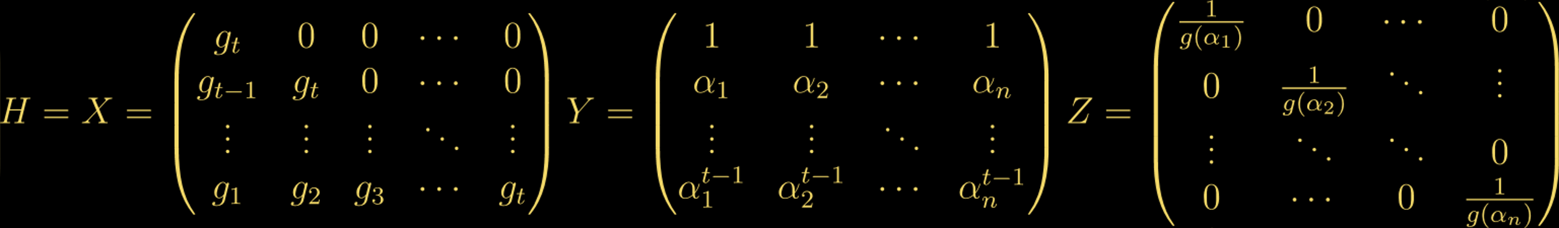
𝐻 a parity check matrix of a Goppa code
for all code vectors 𝑐 in
that satisfy the Goppa code requirement
we set

Slide 14
But why is it specifically Binary Goppa Codes ?
1.Error-Correcting Capability
2.Polynomial Time Encoding and Decoding
3.Large Code Sizes

Slide 15


ALICE
BOB
• Vector 𝑒 of length 𝑘
• 𝑔(𝑧), deg(𝑔)= t over
𝑤𝑡(𝑒) ≤ t
• Compute the 𝑘 × 𝑛 Generator Matrix G
• Encode
• 𝑘×𝑘 invertible matrix S
• 𝑛×𝑛 permutation matrix P
• 𝐺′ = 𝑆GP
Private Key : (𝑔(𝑧), G, S, P)
Public Key : (𝐺′, t)

Slide 16
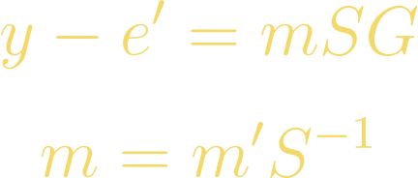
ALICE
BOB
Private Key : (𝑔(𝑧), G, S, P)
Public Key : (𝐺′, t)
Patterson’s algorithm
𝑒′

Slide 17
Final Thoughts

Slide 18
References
[1]Code based Cryptography: Classic McEliece - Harshdeep Singh
[2]White Paper on McEliece with Binary Goppa Codes - Michiel Marcus
[3]Concise Encyclopedia of Coding Theory - Philippe Gaborit & Jean-Christophe Deneuville
[4] NIST : https://csrc.nist.gov/Projects/post-quantum-cryptography/round-4-submissions
[5]Classic McEliece : https://classic.mceliece.org/papers.html
[6]Public Key Cryptosystem Based on Algebraic Coding Theory – R. J. McEliece
[7]On the dimension and structure of the square of the dual of a Goppa code - Rocco Mora, Jean-Pierre Tillich
[8]Goppa Codes and Their Use in the McEliece Cryptosystems - Ashley Valentijn

Slide 19
Thank you for your Active Attention and Listening

